Slide 1
Introduction
Data Mining for Business Analytics (3rd ed.)
Shmueli, Bruce & Patel
© Galit Shmueli and Peter Bruce 2010

Slide 2
Core Ideas in Data Mining
Business Analytics
Data Mining
Related Terms
Big Data
Data Science
So many different methods

Slide 3
Business Analytics
Practice and art of bringing quantitative data to bear on decision making
  Visualization / Business Intelligence
  Understanding
  Predicting
  Optimizing

Slide 4
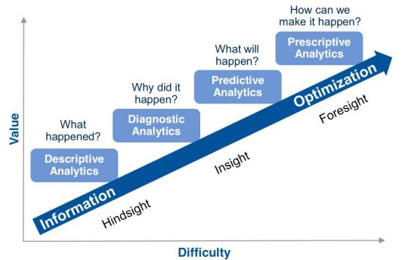
Credit scoring
Future purchases
Tax evasion
Card fraud
Wafer quality

Slide 5
Data Mining
Beyond
  Counts
  Descriptive techniques
  Reporting
  Methods based on business rules
Statistics + Machine Learning

Slide 6
Related Terms
Machine Learning
  Pattern Recognition
  Computer vision
  Artificial Intelligence

Slide 7
Related Terms
인공지능 AI (1946~)
빅데이터 (2000~)
머신 러닝 (1956, 1986, 2005~)
IoT (2010~)

Slide 8
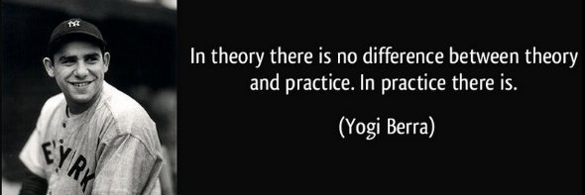
Related Terms
Machine Learning vs Statistics
  Theory rich, data poor vs Data rich, theory poor
    Distribution assumption
    Mathematical rigor
    (management science)

Slide 9
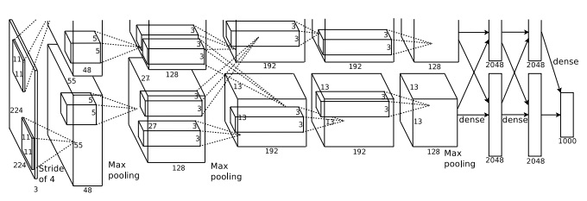
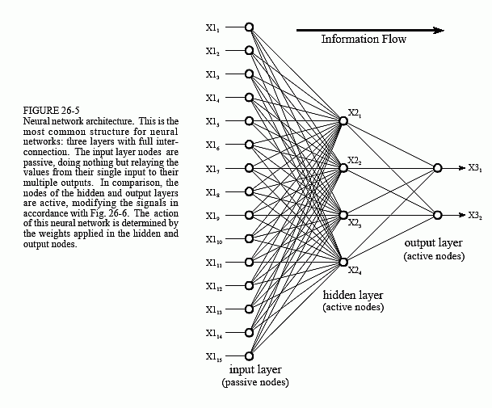
Related Terms
Machine Learning vs Statistics
  Neural networks, Deep Learning vs (Nonlinear) Regression

Slide 10
Related Terms
Machine Learning vs Statistics
  Understanding vs Predicting
    What has happened? vs What will happen?
    Descriptive vs Predictive

Slide 11
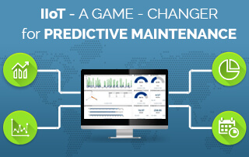
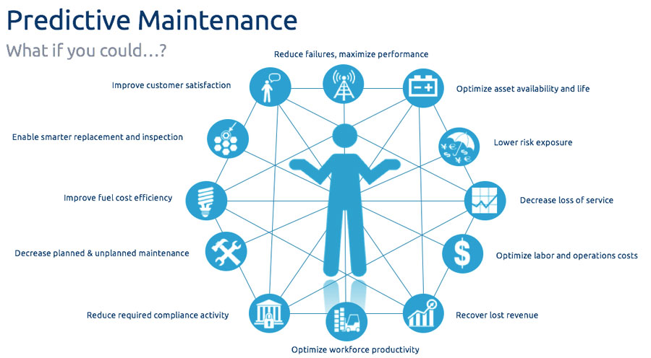
Related Terms
Machine Learning vs Statistics
  Population through sample vs population
    Overall behavior vs individual behavior
    Preventive vs predictive maintenance

Slide 12
Data Science
A mix of skills in
  Statistics
  Machine learning
  Mathematics
  Programming
  Business
  IT
    Database, SQL
    Operating system
    Data manipulation

Slide 13
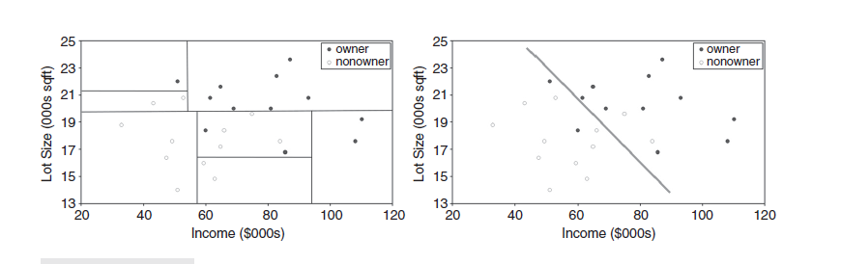
So many methods
Pros and cons
No champion

Slide 14
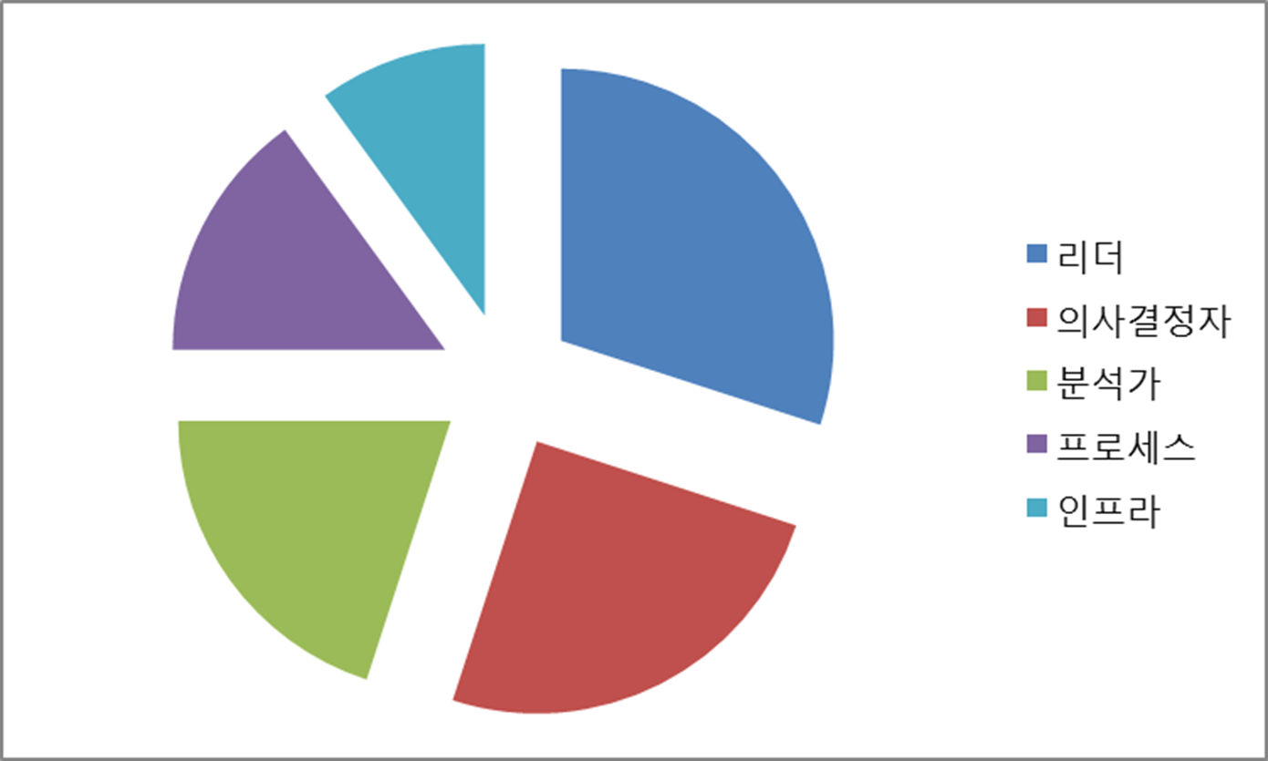
Who’s on?

Slide 15
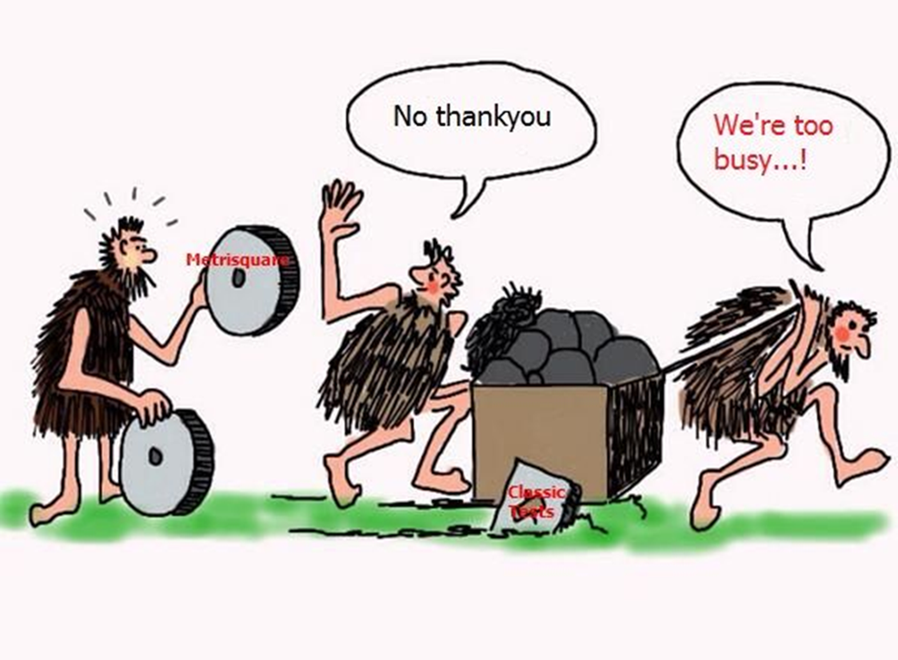
Who’s who?

Slide 16
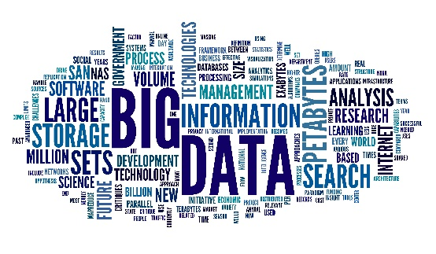



Data ➔ Insight ➔ Value
분석
Data Miner
데이터마이닝
인공지능/머신러닝
액션
Decision Makers
엔지니어
마케터, 투자자, 인사관리

Slide 17
Value ➔ Insight ➔ Data
기획

Slide 18

기획

